Slide 1

Versions
Current Version: 1.0.2
Version Used: 0.9.3

Slide 2





























Big Data Ecosystem
Streaming Engines
Data Store
Data Processing
Peripherals
Data Services
Distributions
Cloud Exposure

Slide 3
Agenda
Introduction
Why Ideal For Real-Time?
Hadoop vs Storm
Storm Architecture
Terminologies
Storm Topology
Workers, Executors, and Tasks
Parallelism
References
Assignment
3

Slide 4
Introduction
Free and Open Source.
Apache Storm is a distributed real-time big data event processing system.
It is a streaming data framework that has the capability of highest ingestion rates.
Continuous Computation & Event Processing
4

Slide 5
Why Ideal For Real-Time?
Fast – benchmarked as processing one million 100 byte messages / second / node.
Scalable – with parallel calculations that run across a cluster of machines.
Fault-tolerant – when workers die, Storm will automatically restart them. If a node dies, the worker will be restarted on another node.
Reliable – each unit of data (tuple) will be processed at least once or exactly once. Messages are only replayed when there are failures.
5

Slide 6
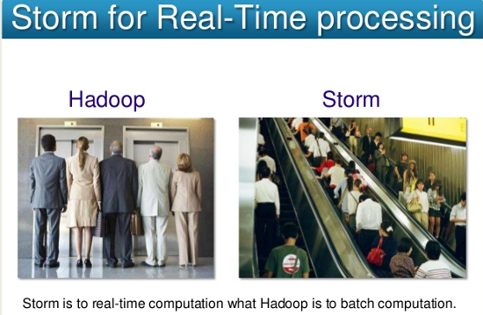
Hadoop Vs Storm
Notes:
6

Slide 7
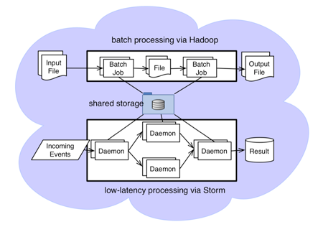
Hadoop vs Storm
Notes:
7

Slide 8
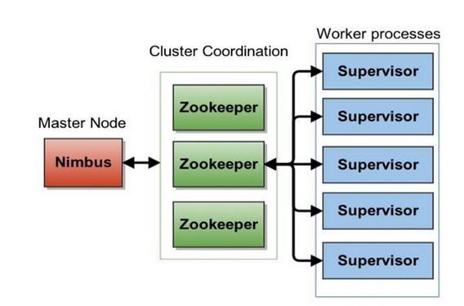
Storm Architecture
8

Slide 9
Storm Architecture
Nimbus is a master node of Storm cluster. All other nodes in the cluster are called as worker nodes. Master node is responsible for distributing data among all the worker nodes, assign tasks to worker nodes and monitoring failures.
Supervisor has multiple worker processes and it governs worker processes to complete the tasks assigned by the nimbus.
Zookeeper is a service used by a cluster to coordinate between themselves and maintaining shared data. It helps the supervisor to interact with the nimbus. It is responsible to maintain the state of nimbus and supervisor.
9

Slide 10
Terminologies
Streams - unbounded sequence of tuples
Spouts - sources of streams
Bolts - process input streams & produce output streams
Topologies - network of spouts and bolts
10

Slide 11






Storm Topology
Hbase
Bolt
Real Time Data
Spout
Bolt
Real time view
cassandra
Bolt
Storm Topology
11

Slide 12
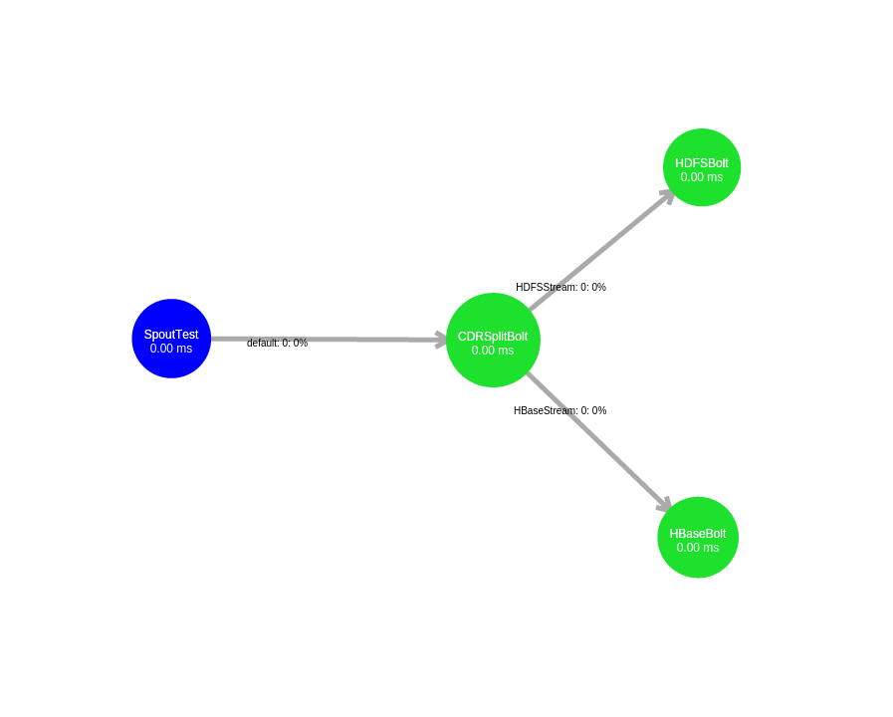
Storm Topology
Public class TestTopology{
………..
TopologyBuilder builder = new TopologyBuilder(); builder.setSpout("CDRSpout", new KafkaSpout(zkSpoutConfig), PARALLELISM_HINT); builder.setBolt("SplitBolt", new SplitBolt()).shuffleGrouping( "CDRSpout"); builder.setBolt("HBaseBolt", new HbaseBolt()).shuffleGrouping( "SplitBolt", "HBaseStream"); builder.setBolt("HDFSBolt", HdfsBolt.getHdfsBolt()) .shuffleGrouping("SplitBolt", "HDFSStream") .shuffleGrouping("HBaseBolt");
………..
}
Public class CDRSplitBolt extends BaseRichBolt{
public void execute(Tuple tuple){...}
}
Public class HbaseBolt extends BaseRichBolt{
public void execute(Tuple tuple){...}
}
Notes:
12

Slide 13
Workers, Executors, and Tasks
Apache Storm processes, called workers, run on predefined ports on the machine that hosts Storm.
worker process can run one or more executors, or threads, where each executor is a thread runs in the worker process.
Each executor runs one or more tasks from the same component, where a component is a spout or bolt from a topology.
13

Slide 14
Parallelism
Distributed applications take advantage of horizontally-scaled clusters by dividing computation tasks across nodes in a cluster. Storm offers this and additional ways to increase the parallelism of a Storm topology.
Increase the number of workers
Increase the number of executors
Increase the number of tasks
14

Slide 15
Parallelism
By default, Storm uses a parallelism factor of 1. Assuming a single-node Storm cluster, a parallelism factor of 1 means that one worker, or JVM, is assigned to execute the topology, and each component in the topology is assigned to a single executor.
The topology defines a data flow with three tasks, a spout and two bolts.
15

Slide 16
Parallelism
Increasing Parallelism with Workers
We can easily increase the number of workers assigned to execute a topology with the Config.setNumWorkers() method. This code assigns two workers to execute the topology, as the following figure illustrates.
...
Config config = new Config(); config.setNumWorkers(2);
...
16

Slide 17
Parallelism
Increasing Parallelism with Executors
We can specify the number of executors for each worker with a parallelism hint, an optional third parameter to the setBolt() method.
...
Config config = new Config();
TopologyBuilder builder = new TopologyBuilder(); builder.setSpout(MY_SPOUT_ID, mySpout); builder.setBolt(MY_BOLT1_ID, myBolt1, 2).shuffleGrouping(MY_SPOUT_ID); builder.setBolt(MY_BOLT2_ID, myBolt2).shuffleGrouping(MY_SPOUT_ID);
...
17

Slide 18
Parallelism
Increasing Parallelism with Tasks
We can increase the number of tasks assigned to a single topology component, such as a spout or bolt. By using with the setNumTasks() method on the Bolt and Spout.
...
Config config = new Config();
TopologyBuilder builder = new TopologyBuilder(); builder.setSpout(MY_SPOUT_ID, mySpout); builder.setBolt(MY_BOLT1_ID, myBolt1).setNumTasks(2).shuffleGrouping(MY_SPOUT_ID); builder.setBolt(MY_BOLT1_ID, myBolt2).shuffleGrouping(MY_SPOUT_ID);
...
18

Slide 19
Parallelism
Putting it All Together
...
Config config = new Config();
config.setNumWorkers(2);
TopologyBuilder builder = new TopologyBuilder(); builder.setSpout(MY_SPOUT_ID, mySpout, 2).setNumTasks(4); builder.setBolt(MY_BOLT1_ID, myBolt1, 2).setNumTasks(2).shuffleGrouping(MY_SPOUT_ID); builder.setBolt(MY_BOLT2_ID, myBolt2).shuffleGrouping(MY_SPOUT_ID); ...
19

Slide 20
Reference
Apache Storm see site : https://storm.apache.org/
Downloading Storm:http://storm.apache.org/downloads.html
Documentation:
Storm : http://storm.apache.org/releases/1.0.2/index.html

Slide 21


Test Yourself
Answer the following questions:
What is apache Storm?
Which components are used for stream flow of data?
What are the key benefits of using Storm ?
What are the key components in Storm Architecture?
distributed real time computation system.
Nimbus,Supervisor,zookeeper.
What Key difference between storm and Hadoop?
Bolt, Spout, Tuple.
Storm is real time computation. Hadoop is batch processing computation system.
What happens if worker dies?
Real fast , Fault tolerant,Reliable,Scalable
When a worker dies, the supervisor will restart it. If it continuously fails on startup and is unable to heartbeat to Nimbus, Nimbus will reassign the worker to another machine.

Slide 22
Questions?

Slide 23
Assignment
Install Storm
Write a storm topology program using java and submit to cluster.
23

